Slide 1
Checkpoint 2 & 3
Yichen Sheng

Slide 2

Recap
Spherical harmonics
Basis are orthogonal with each other
Integration is reduced to dot product

Slide 3
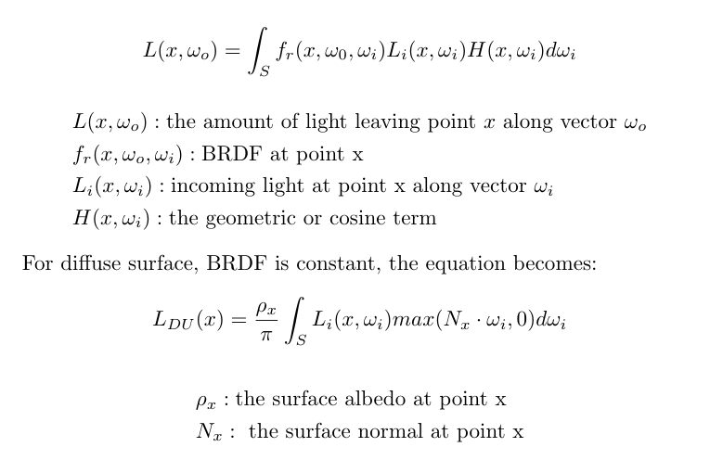
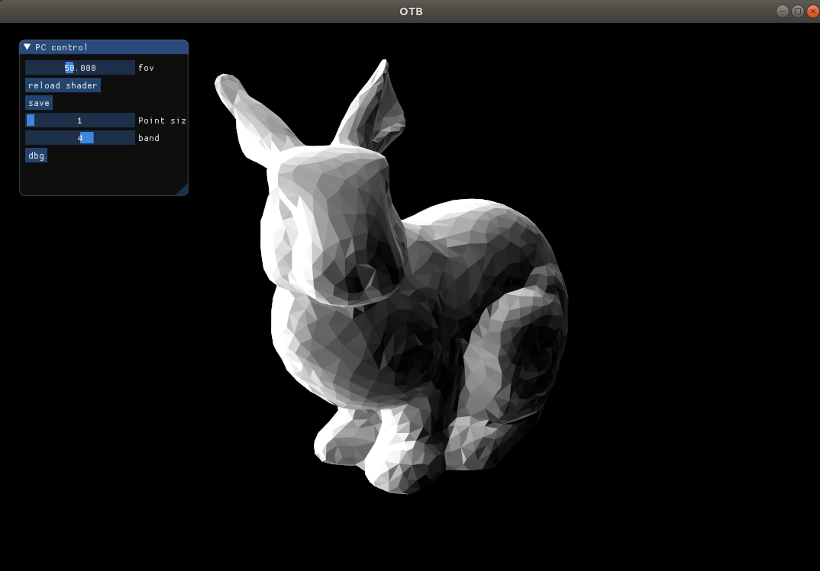
Diffuse (unshadowed) SH rendering (4 bands)

Slide 4
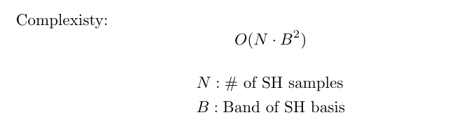
Diffuse (unshadowed) SH rendering (4 bands)
For each vertex:

Slide 5
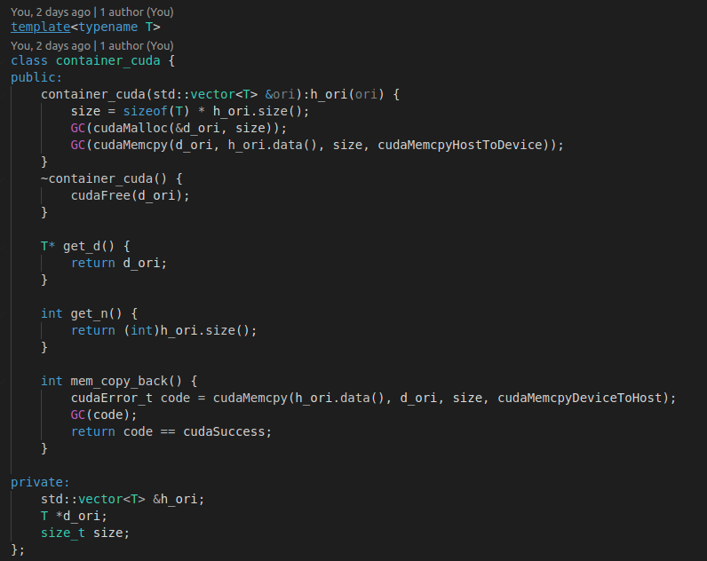
Implementation details
Cuda helper container

Slide 6
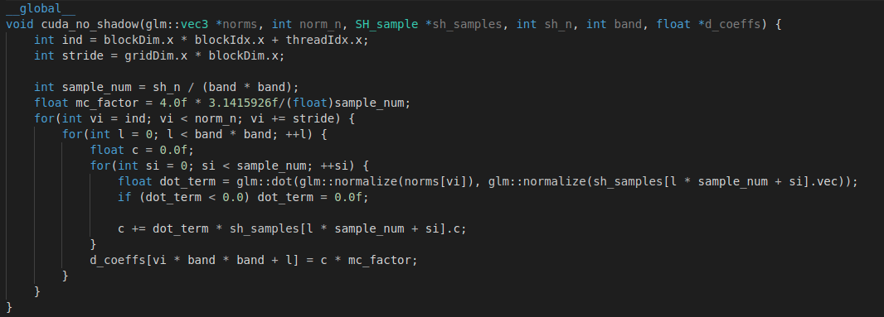
Implementation details
Projection into SH basis, monte carlo integration
For each vertex
For each basis
Monte carlo integration

Slide 7
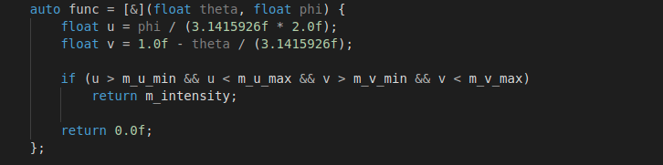
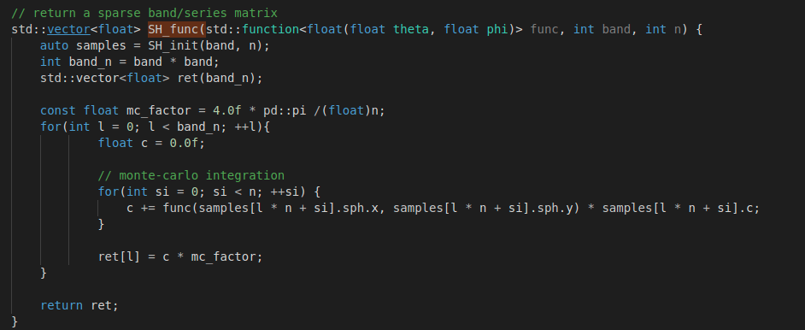
Implementation details
Projection lighting into SH basis, monte carlo integration

Slide 8
Diffuse (unshadowed) SH rendering

Slide 9
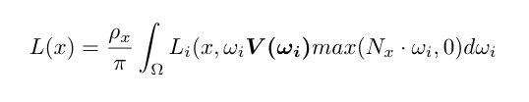
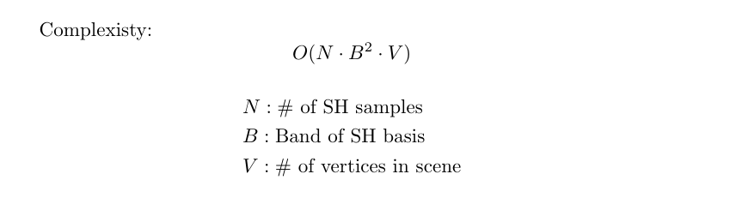
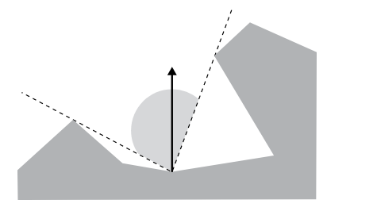
Diffuse (shadowed) SH rendering

Slide 10
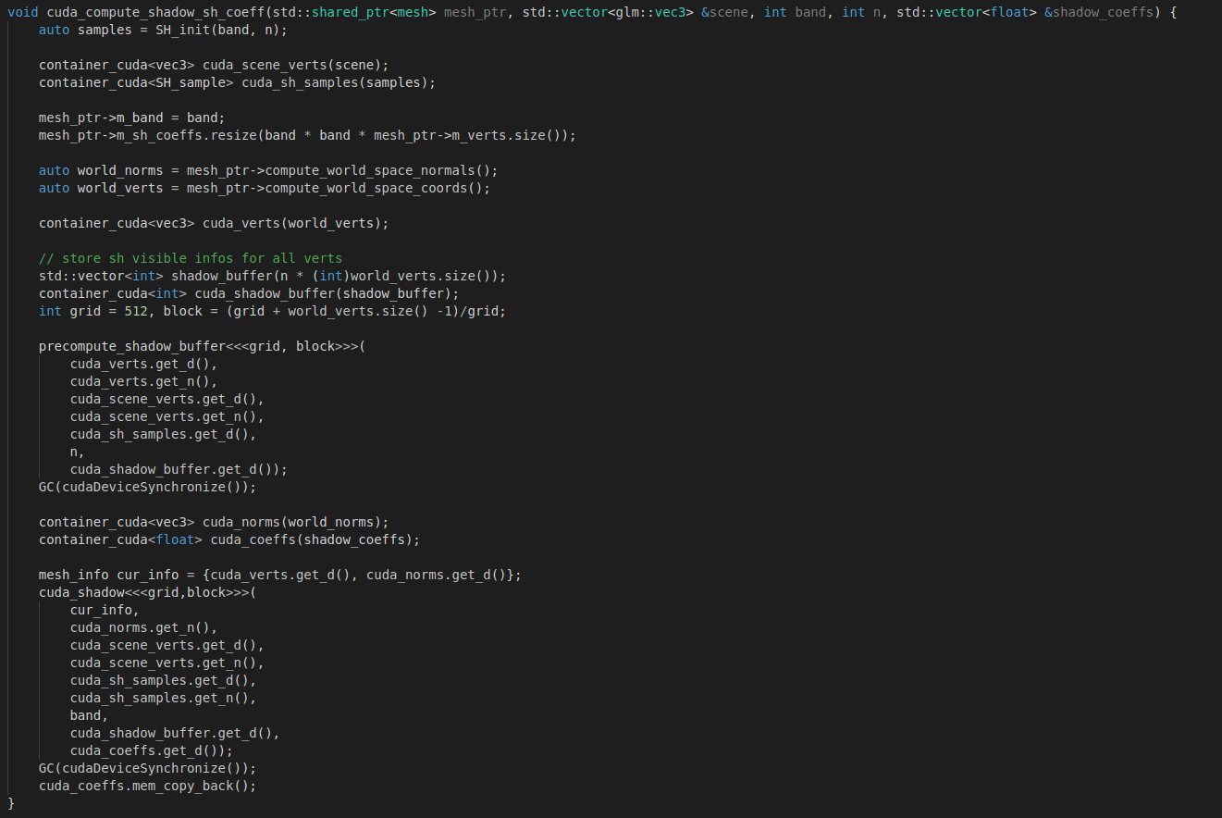
Implementation details
visibility buffer: (x, y, z, theta, phi) -> 0/1
Project visibility into SH basis

Slide 11
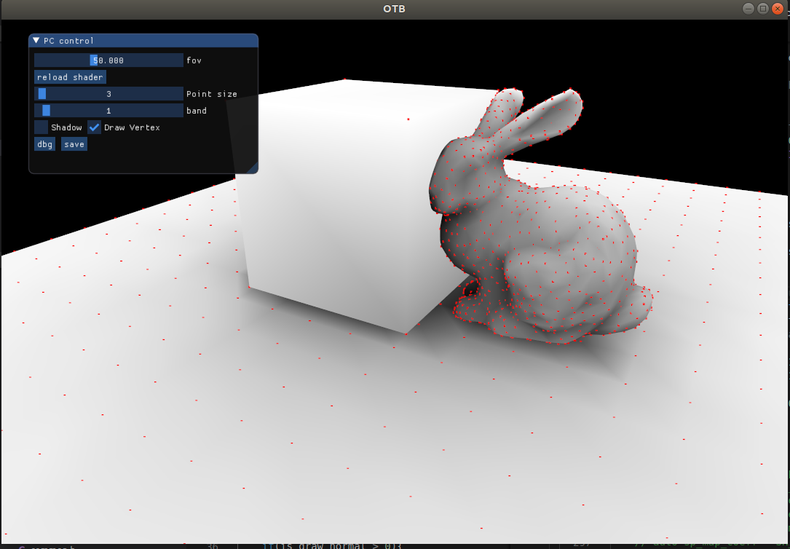
Visibility

Slide 12
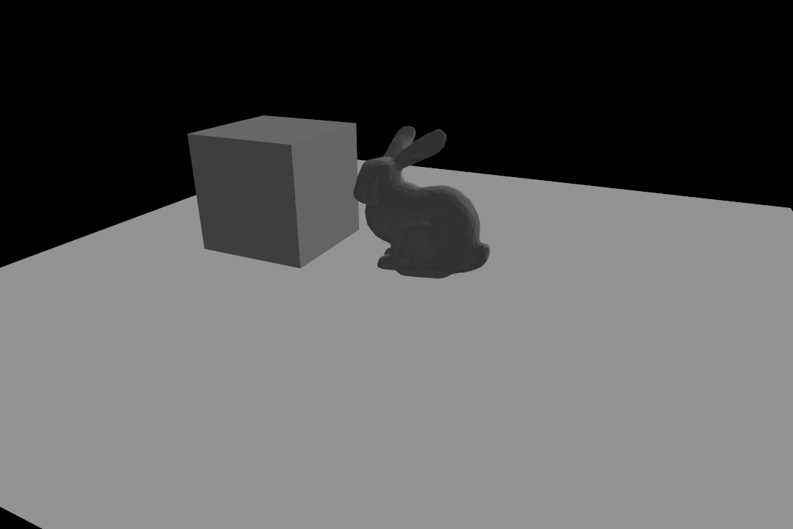
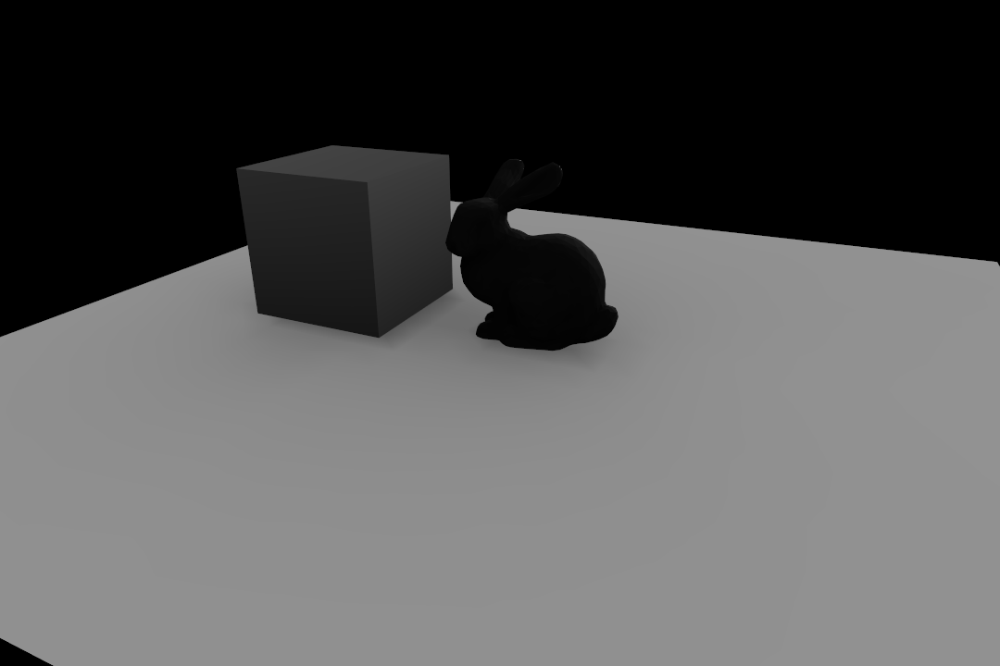
Diffuse(shadowed) SH rendering

Slide 13
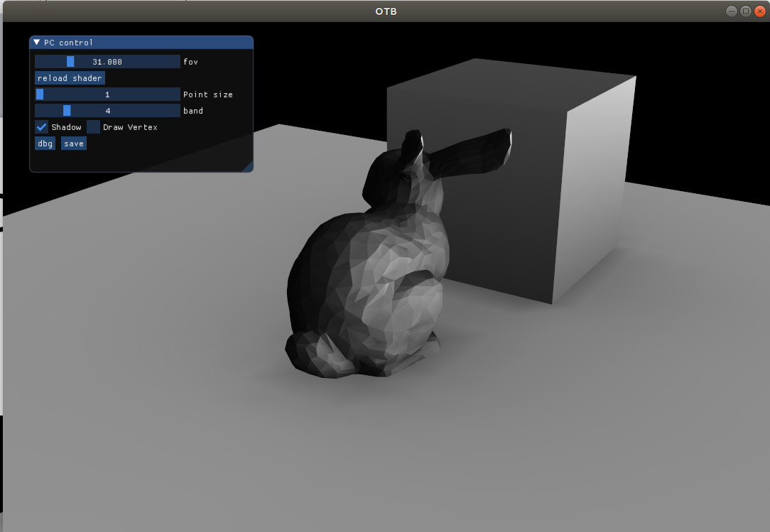
Diffuse(shadowed) SH rendering

Slide 14
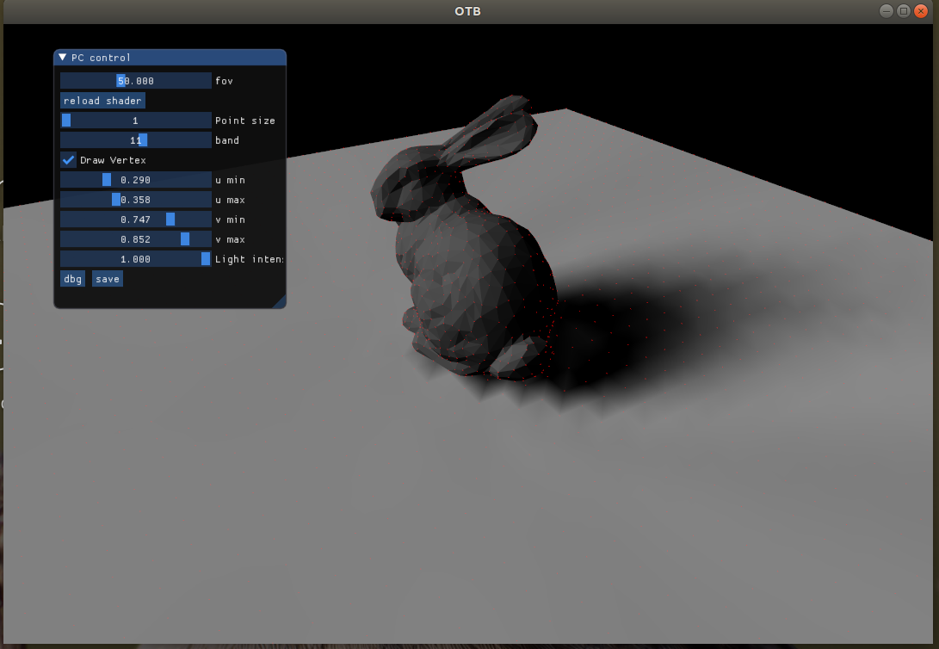
Exps
Cast shadows onto the plane.
Plot shadows w.r.t. SH bands.
Live demo!

Slide 15
Conclusions
Pros:
Efficient rendering in runtime
General basis for integral of spherical surface
Low level details from low order basis
Cons:
1. It's hard to use SH to render hard shadows
even use 11 band (121 bases)
2. Shadow resolution depends on vertices of shadow
receiver
3. Static scene, visibility test is expensive to compute

Slide 16
Exp on bands (1~11)

